Slide 1
COMPONENTS OF CONSUMER INFORMATION PROCESSING
Exposure: This is the initial contact a consumer has with information about a product, service, or brand. It could be through an advertisement you see while browsing social media (e.g., a video ad for a new phone on Facebook), a billboard you pass on your way to work (e.g., a billboard for a fast-food restaurant), or even a conversation you overhear (e.g., two friends talking about a new fitness tracker).
Attention: Not all information we're exposed to gets noticed. Attention is the process of focusing on specific stimuli out of the bombardment we constantly encounter. Marketers try to grab attention with eye-catching visuals, catchy slogans (e.g., a juice brand using the slogan "The taste that wakes you up!"), or strategic product placement in movies or TV shows.
Comprehension: Once a consumer notices something, they need to understand it. Comprehension involves interpreting the information and making sense of it. A clear and concise product description (e.g., highlighting the megapixel count and low-light capabilities of a new camera) or a well-designed infographic (e.g., showcasing the ingredients and benefits of a new cereal) can aid comprehension.
Elaboration: This is the deepest level of processing. Here, the consumer goes beyond just understanding the information and actively thinks about how it relates to them. They might consider their needs and wants (e.g., needing a phone with a long battery life for traveling), compare the product to similar options (e.g., researching other camera brands before deciding), or even imagine themselves using the product (e.g., picturing how a new pair of sneakers would look with their favorite outfit). Effective marketing campaigns can encourage elaboration by prompting consumers to think about their problems and how the product can solve them.

Slide 2
INFORMATION PROCESSING THEORY
Encoding: This is where consumers transform information they encounter into a format their memory can understand and retain. Imagine you're browsing online reviews for a new restaurant (information encounter). You might focus on keywords like "delicious," "authentic," or "long wait" (encoding the most relevant details). Types of encoding: semantic, visual, acoustic encoding
Storage: Not all encoded information sticks. Storage refers to how consumers retain the encoded information over time. Seeing a commercial for a new car with a catchy jingle might make the brand name stick in your head for a short while (short-term storage). However, repeatedly reading positive reviews about a specific restaurant might lead you to remember its name and consider trying it (long-term storage). Factors like repetition, emotional connection, and personal relevance all influence how well information is stored.
Retrieval: This is the stage where consumers dig up the stored information when faced with a decision. When you're feeling hungry and trying to decide where to eat, you might retrieve the restaurant name you remembered from the positive reviews (information retrieval). The retrieval process can be triggered by internal cues (e.g., feeling hungry) or external cues (e.g., seeing a restaurant sign).

Slide 3
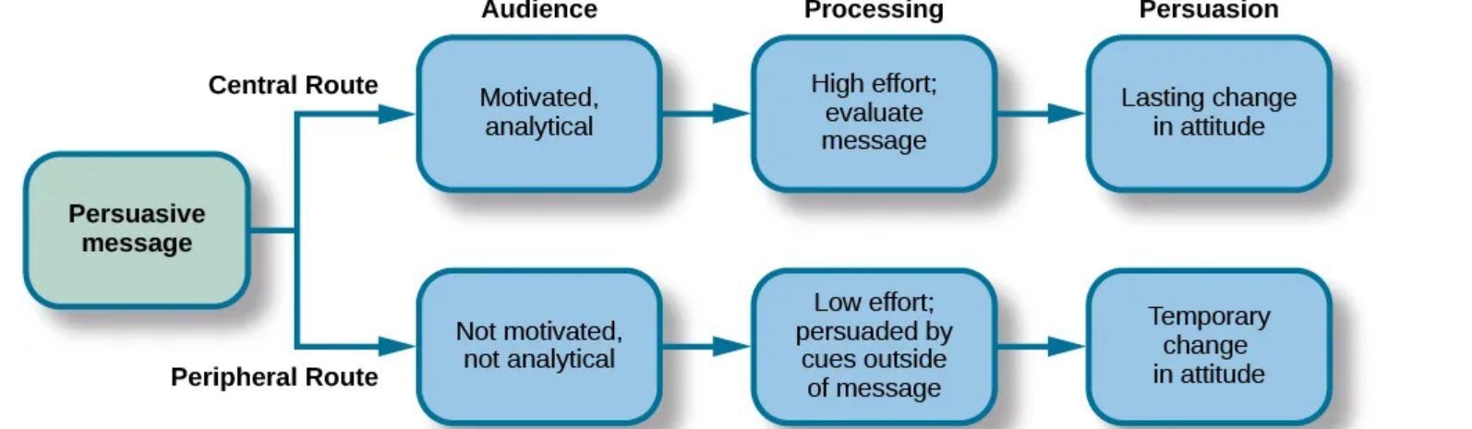
CENTRAL AND PERIPHERAL ROUTES TO PERSUASION
The central route is logic driven and uses data and facts to convince people of an argument’s worthiness.
The peripheral route is an indirect route that uses peripheral cues to associate positivity with the message. Instead of focusing on product’s quality, the peripheral route relies on the association with positive characteristics such as positive emotions and celebrity endorsement.

Slide 4
LEVELS OF CONSUMER DECISION MAKING
1. Extensive Problem Solving: This is the most involved level of decision-making, used for high-risk or unfamiliar purchases. It involves a lot of information gathering and evaluation.
Example: Imagine you're buying a new laptop for college. This is likely a high-involvement purchase as it requires extensive research. You might compare features, prices across different brands (information search), read reviews (evaluation of alternatives), and consider factors like processing power, battery life, and warranty (elaboration) before making a choice (purchase decision).
2. Limited Problem Solving: This level is used for moderately familiar products or situations where there's some risk involved. Consumers engage in some research but rely on past experiences and brand knowledge. Purchasing process is shorter. This type occurs mostly while purchasing a new or updated version of product/service they had already purchased.
Example: Let's say you need to buy a new pair of running shoes. You might be familiar with different brands and have a general idea of what features you need (e.g., cushioning for long runs). You might browse different brands online or visit a store to compare options (limited information search) based on past experiences or brand reputation, but the decision might not involve extensive research like buying a laptop.
3. Routinized Response Behavior: This is the most basic level of decision-making used for low-risk, habitual purchases. Consumers rely on past experiences and brand loyalty, making quick decisions with minimal information search.
Example: Picking up your favorite brand of milk at the grocery store is a routine purchase. You're familiar with the product, trust the brand, and likely won't spend much time comparing different options (minimal information search). You might rely on brand loyalty or simply repurchase what you've bought before.

Slide 5
CONSUMER DECISION MAKING MODELS
1. Economic Model: This model views consumers as rational decision-makers who prioritize maximizing utility (getting the most value) for their money post evaluation without getting influenced. They carefully weigh options based on price, features, and benefits.
Example: Imagine you're comparing two TVs with similar features. The economic model suggests you'd choose the one with the lower price, assuming quality is comparable. Marketers using this model might emphasize price promotions and clear value propositions in their advertising.
2. Behavioral Model: This model focuses on how external factors like social influence, marketing messages, and habits influence consumer choices, sometimes without much conscious thought.
Example: Seeing everyone around you using a particular brand of phone might influence you to choose the same brand, even if you haven't actively compared features (social influence). Marketers using this model might leverage celebrity endorsements or social media influencers to promote their products.
3. Emotional Model: This model highlights the role of emotions and feelings in consumer decision-making. Consumers might prioritize products that evoke positive emotions like happiness, excitement, or nostalgia. Customers become impulsive and take relatively less time in decision-making.
Example: Choosing a luxurious brand of perfume over a drugstore brand might be driven by the desire to feel glamorous or confident (emotional connection). Marketers using this model might create advertising campaigns that focus on the emotional experience of using their product.
4. Cognitive Model: This model emphasizes the mental processes consumers go through when making decisions. It focuses on information processing stages like problem recognition, information search, evaluation of alternatives, and post-purchase evaluation. Example: The cognitive model explains the steps you take when buying a new laptop (extensive problem solving) - researching features, comparing brands, and considering your needs before making a purchase.

Slide 6
MULTI BRAND STRATEGY
A multi-brand strategy means having a portfolio of products with different brands or names, all owned and managed by the same company.
1. Flanker Brand: A flanker brand is a marketing strategy where a company introduces a new product or service to target a specific segment, while maintaining the integrity of the existing parent brand. This approach is primarily used to appeal to different customer preferences and protect market share.
Example: Dove launched "Dove Men+Care" as a flanker brand. This caters to men who might not be interested in the core brand's positioning towards women but still value the Dove reputation for quality.
2. Fighter Brand: A fighter brand is specifically designed to compete directly with another brand in the market, often at a lower price point. Its goal is to capture market share from the competitor.
Example: AmazonBasics is a fighter brand launched by Amazon to compete with established brands in various product categories. They offer similar quality products at a lower price, appealing to budget-conscious consumers.
3. Brand Line Extension: This involves extending an existing brand name to a new product category. The brand extension leverages the existing brand awareness and reputation to introduce the new product.
Example: Nivea launched a line of deodorants under the same brand name. Consumers familiar with Nivea's quality and trust might be more likely to try their deodorants.

Slide 7
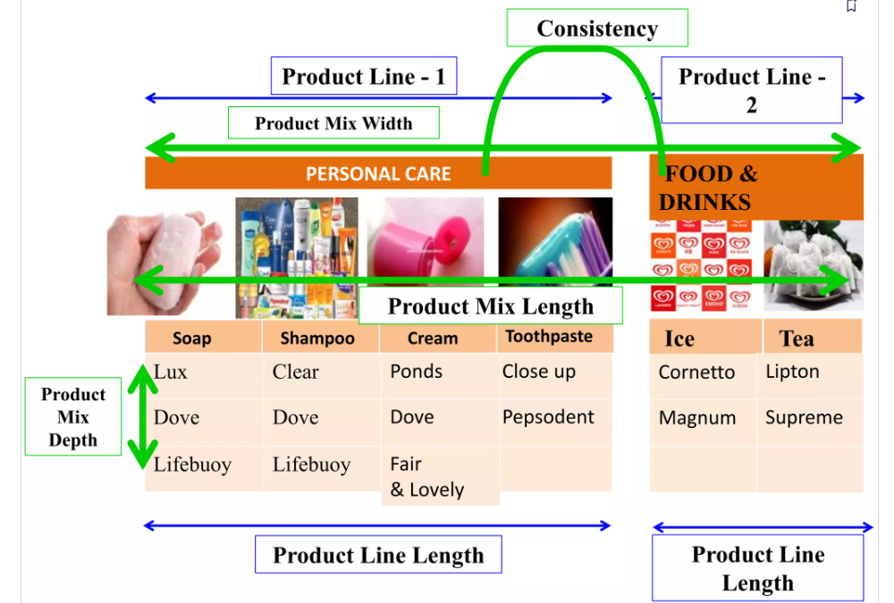
PRODUCT MIX
Width → How many different product line the company has
Length → Total no. of items in the mix
Depth → No.of variants offered
Consistency → How closely related various product lines are

Slide 8
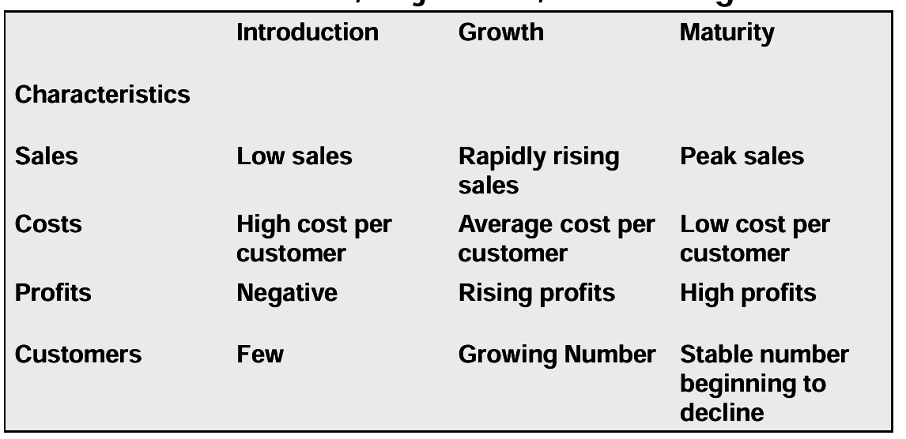
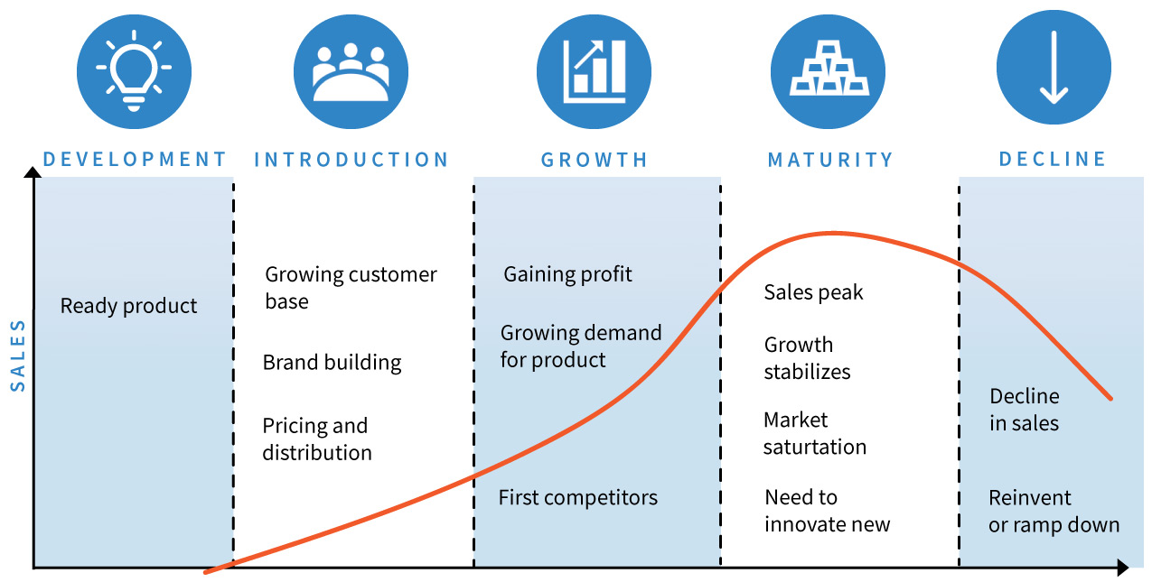


PRODUCT LIFE CYCLE
Product Extension

Slide 9
MARKETING STRATEGIES
GROWTH STAGE
Add new flanker products
Increase distribution coverage
Lower prices to attract buyers
MATURITY STAGE
Market Modification by expanding number of brand users by entering new market segments and winning competitors’ customers
Convince current users to increase usage by using the product on more occasions and in new ways
Product modification by quality & feature improvement
Marketing-Mix Modification - Prices Distribution , Advertising, Sales , Promotion Services
DECLINE STAGE
Increase firm’s investment (to dominate the market and strengthen its competitive position)
Maintain the firm’s investment level until the uncertainties about the industry are resolved.
Decrease the firm’s investment level selectively by dropping unprofitable customer groups, while simultaneously strengthening the firm’s investment in lucrative niches

